Slide 1
Forest Management and the Expanding Global Forest Carbon Sink
Brent Sohngen (Ohio State University)
Robert Mendelsohn (Yale University)
With many thanks to: Xiaohui Tian (Renmin Univeristy of China), Justin Baker (RTI International), Sara Ohrel (USEPA), Allen Fawcett (USEPA)

Slide 2
Over the last century…
Income per capita rose from $679/person to $7500/person (Maddison; DeLong; Nordhaus)
Population rose from 1.6 billion to 6.1 billion
House size increased from 1500 ft² to over 2500 ft² asdf
Pulpwood expanded
An additional 800 million ha were deforested and converted to agriculture (Houghton, 1999, 2003), and 500 million ha were officially reserved.
New values for environment reserved large additional areas of private lands with non policy intervention.
Unprecedented increase in human welfare.
Global average per capita Income

Slide 3
Over the last century…
Income per capita rose from $679/person to $7500/person (Maddison; DeLong; Nordhaus)
Population rose from 1.6 billion to 6.1 billion
House size increased from 1500 ft² to over 2500 ft² asdf
Pulpwood expanded
An additional 800 million ha were deforested and converted to agriculture (Houghton, 1999, 2003), and 500 million ha were officially reserved.
New values for environment reserved large additional areas of private lands with non policy intervention.
Unprecedented increase in human welfare.
US Timber Consumption/Production

Slide 4
What happened to the world’s forests?

Slide 5
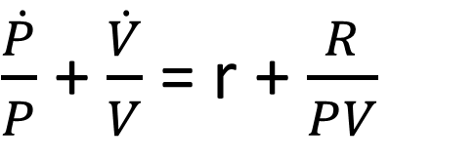
Forestry became sustainable on a global basis
Prices and stocks stabilized...
$\frac{\dot{P}}{P}$ + $\frac{\dot{V}}{V}$ = r + $\frac{R}{PV}$

Slide 6
Forestry became sustainable on a global basis
Carbon has
continued to
increase in
the world’s
forests
Since 1900, the net of the
Residual land sink and
Deforestation has been an
Increase in carbon by over
200 million tons C/yr globally
IPCC, 2014

Slide 7
Forest Sustainability
Land use change – forest expansion
Harvesting patterns
Age class of harvest
Land set-aside for economic and environmental purposes.
Forest investments (plantations)
Fire exclusion/rotation management
CO₂ fertilization
Oswalt et al. (2012)
This trend has emerged throughout the world
Europe, Russia, China, South America

Slide 8
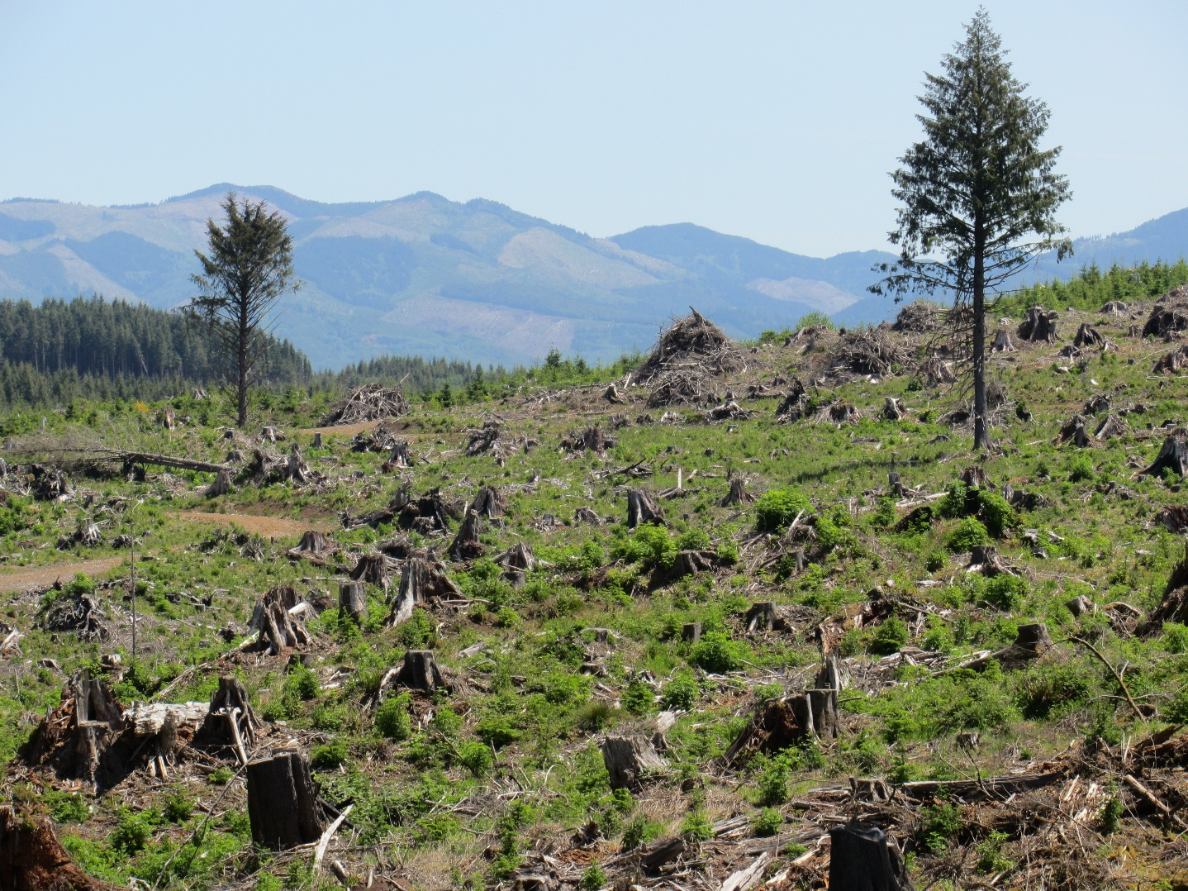
Forest Sustainability
Land use change – forest expansion
Harvesting patterns
Age class of harvest
Land set-aside for economic and environmental purposes.
Forest investments (plantations)
Fire exclusion/rotation management
CO₂ fertilization
USDA Forest Service FIA data
Forest Inventory Data Online
http://apps.fs.fed.us/fia/fido/index.html

Slide 9
Forest Sustainability
Land use change – forest expansion
Harvesting patterns
Age class of harvest
Land set-aside for economic and environmental purposes.
Forest investments (plantations)
Fire exclusion/rotation management
CO₂ fertilization
USDA Forest Service FIA data
Forest Inventory Data Online
http://apps.fs.fed.us/fia/fido/index.html

Slide 10
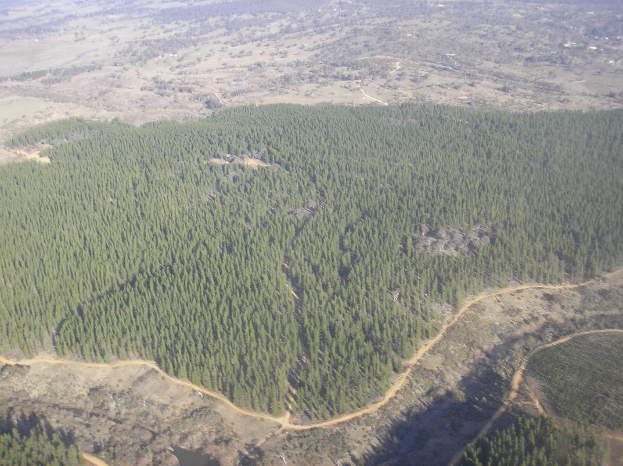
Forest Sustainability
Land use change – forest expansion
Harvesting patterns
Age class of harvest
Land set-aside for economic and environmental purposes.
Forest investments (plantations)
Fire exclusion/rotation management
CO₂ fertilization
Over 100 million ha of plantations globally
With significant investment in subtropics

Slide 11
Forest Sustainability
Land use change – forest expansion
Harvesting patterns
Age class of harvest
Land set-aside for economic and environmental purposes.
Forest investments (plantations)
Fire exclusion/rotation management
CO₂ fertilization
Over 100 million ha of plantations globally
With significant investment in subtropics

Slide 12
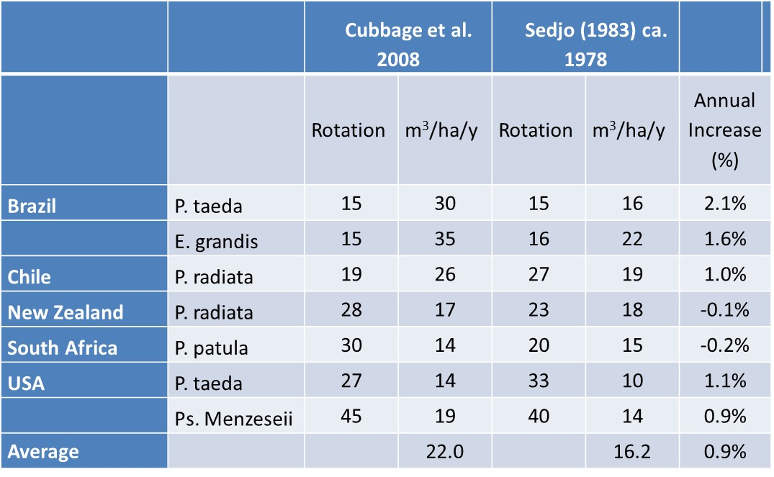
Forest Sustainability
Land use change – forest expansion
Harvesting patterns
Age class of harvest
Land set-aside for economic and environmental purposes.
Forest investments (plantations)
Fire exclusion/rotation management
CO₂ fertilization

Slide 13
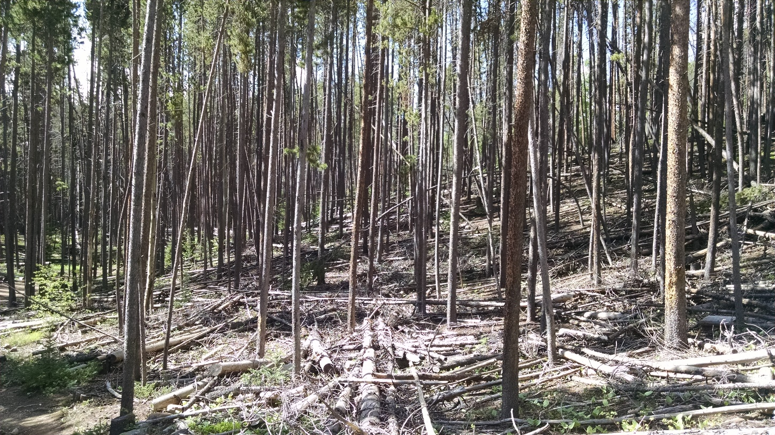
Forest Sustainability
Land use change
Harvesting patterns
Age class of harvest
Land set-aside for economic and environmental purposes.
Forest investments (plantations)
Fire exclusion/rotation management
CO₂ fertilization
Various Sources

Slide 14
Forest Sustainability
Land use change
Harvesting patterns
Age class of harvest
Land set-aside for economic and environmental purposes.
Forest investments (plantations)
Fire exclusion/rotation management
CO₂ fertilization
Various Sources

Slide 15
What drives the current sink?
Land use change – forest expansion
Harvesting patterns
Age class of harvest
Land set-aside for economic and environmental purposes.
Forest investments (plantations)
Fire exclusion/rotation management
CO₂ fertilization

Slide 16
Questions?
Why has the sink grown?
Carbon fertilization (60%)
Forest management (40%)
Is this sustainable?
The demand for forest resources continues to increase:
Traditional timber products (building materials, paper, cardboard)
Energy (biomass and biofuels) + CCS
Carbon sequestration
Habitat/biodiversity
Water quality
To address these questions, we develop an intertemporal optimization approach to assess historical and future forest management
Historical Analysis: Start in 1900 and model the last century.
Future Analysis: Start in 2015 and model the next century.

Slide 17
Intertemporal economic model
Based on earlier TSM and GTM (Sedjo and Lyon, 1990; Sohngen et al., 1999; Daigneault et al., 2008, 2012).
Global timber demand is exogenous and driven by population, income and technology change.
Dynamic forests: Timber production determined by optimization over forest age classes, area of accessible and inaccessible land, planting, and management intensity.
Keep track of age classes.
Keep track of investments.
Keep track of where forests are located.
Forest types: 250 globally, tied to biomes in MC1/2 Dynamic Global Vegetation Model
Land demand driven by agricultural markets, but exogenous to model (rents exogenously specified).
Prices determined endogenously .

Slide 18
Assumptions - Historical Analysis
Initial forests: Assume forests start as old growth in most locations (some younger stands in the eastern US and Europe); old growth in tropics (so no accumulation there due to aging)
Income per capita rises from $1263/person to $6038/person (Maddison; DeLong; Nordhaus)
Population rises from 1.6 billion to 6.1 billion from 1900 - 2010

Slide 19
Assumptions - Historical Analysis
Carbon Fertilization:
CO2 concentration increased from 290 to 369 ppm from 1900 to 2010, or a 27% increase.
Norby et al. (2006) suggest a 23% increase in net primary productivity in forests when CO2 increases from 376 to 550 ppm. Other studies have shown larger and smaller effects.
Each 1% increase in CO2 concentration, increases NPP by 0.65%
We assume NPP increases 17% due to carbon fertilization

Slide 20
Assumptions - Historical Analysis
Forest fires: Use MC1 model to predict forest fires by region and forest type.
Incorporate controls that reduce the effects of natural fires by 80% globally over the century.

Slide 21
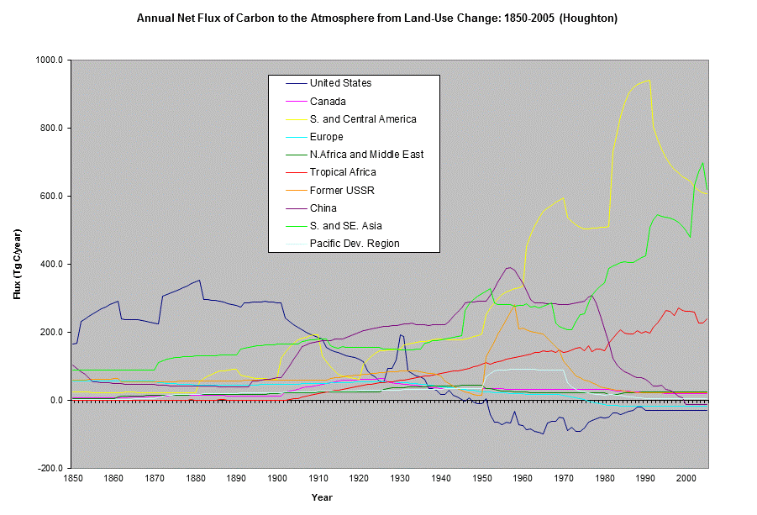
Assumptions - Historical Analysis
Land Use: Use rental functions to match the aggregate trends in land conversion predicted by Houghton over the past century.

Slide 22
Results – Historical Analysis
Old growth extraction (non-renewable) drives timber prices upward by 3-4% per year through 1980
Timber prices slow down post 1980 as transition to renewable forestry occurs: Sohngen and Haynes (1994) and Haynes (2008)

Slide 23
Harvests in 20th Century

Slide 24
Forest Management and Plantations
Industrial Plantations

Slide 25
Land Areas
 | Intensive Plantations | Moderately Intensive Mgmt | Primary forest (low intensity use) | Total
North America
1910 | 0.0 | 0.3 | 642.9 | 643.2
1960 | 12.1 | 44.8 | 601.4 | 658.3
2010 | 27.3 | 108.4 | 561.9 | 697.6
Europe
1910 | 0.0 | 0.6 | 1114.6 | 1115.1
1960 | 22.8 | 32.9 | 970.1 | 1025.8
2010 | 44.8 | 120.3 | 902.6 | 1067.6
South & Central America
1910 | 0.0 | 2.1 | 1204.3 | 1206.4
1960 | 5.6 | 37.5 | 1136.8 | 1179.9
2010 | 13.1 | 40.3 | 957.1 | 1010.5
Asia
1910 | 0.4 | 0.0 | 703.6 | 703.6
1960 | 11.7 | 0.0 | 624.8 | 635.6
2010 | 47.2 | 40.1 | 490.6 | 577.9
Rest of World
1910 | 0.0 | 0.0 | 1254.7 | 1254.7
1960 | 2.6 | 0.0 | 1134.6 | 1137.3
2010 | 7.8 | 1.8 | 905.5 | 915.0
World
1910 | 0.4 | 2.5 | 4920.0 | 4923.0
1960 | 54.8 | 114.3 | 4467.8 | 4636.9
2010 | 140.2 | 310.9 | 3817.6 | 4268.7

Slide 26
Deforestation
South America
SE Asia
Sub Saharan
Africa

Slide 27
Global Carbon
These results are consistent with a large accumulation of carbon in the world’s ecosystems.
Markets amount to
260 million tons C
per year

Slide 28
How important are carbon fertilization and forest management?
Carbon
Timber Prices
- 44 Pg for no CO2 fertilization
- 27 Pg for no forest management

Slide 29
Impact on Cumulative Carbon Emissions (Gt C)
1900-2010 | Land
 | Pg C
Deforestation Total from IPCC | 132.5
Carbon Fertilization | - 43.5
Forest Management | - 26.8
Natural Regrowth | - 55.6
Net (our estimate) | -6.6

Slide 30
Effect of Management on recent US flux
Effect in US in 1995 | Tg C/yr | Tg C/yr | % lost
Forest Management/ No Climate Change | 21.1
Forest Management/ Climate Change | 74.3 | 53.2
No Forest Management/ Climate Change | 43.7 | 22.6 | 58%
No Fire Management/ Climate Change | 66.1 | 45.0 | 15%
No Fire Man/No For Man/ No Regen/Climate Change | 18.6 | -2.5 | 105%
Effect in US in 2005 | Tg C/yr | Tg C/yr | % lost
Forest Management/ No Climate Change | 27.0
Forest Management/ Climate Change | 136.7 | 115.6
No Forest Management/ Climate Change | 93.8 | 72.7 | 37%
No Fire Management/ Climate Change | 117.3 | 96.2 | 17%
No Fire Man/No For Man/ No Regen/Climate Change | 1.5 | -19.6 | 117%

Slide 31
Looking forward…
Demand for traditional wood products still important
Demand for biofuels may be increasing
Will forests still be a sink?

Slide 32
GTM Global Prices and Harvests
Prices
Quantities

Slide 33
Global Carbon Sequestration

Slide 34
US Forest Carbon Sequestration by Type

Slide 35
Sensitivity of Results to Alternative Economic Assumptions

Slide 36
Does Climate Change Alter the Results?
 |  | Baseline | No Land Use Change | 2010 Management | 2010 Management/No Land Use Change | Management=0/No Land Use Change | High Demand
Without Climate Change Impacts | Aboveground Tg C in 2050 | 24,654 | 24,088 | 24,570 | 24,082 | 23,182 | 25,732
 | % difference from baseline |  | -2.3% | -0.3% | -2.3% | -6.0% | 4.4%
 | Aboveground Tg C in 2100 | 27,803 | 25,982 | 27,518 | 25,726 | 24,235 | 31,952
 | % difference from baseline |  | -6.6% | -1.0% | -7.5% | -12.8% | 14.9%
With Climate Change Impacts (Average and min and max of scenarios) | Aboveground Tg C in 2050 | 24,727 (24274,25221) | 24,248 (23709, 24800) | 24,638 (24118, 25182) | 24,152 (23575, 24756) | 23,439 (22802, 23937) | 25,704 (25334, 26202)
 | % difference from baseline |  | -1.9% (-1.7, -2.3) | -0.4% (-0.2, -0.6) | -2.3% (-1.8, -2.9) | -5.2% (-5.1, -6.1) | 4% (3.9, 4.4)
 | Aboveground Tg C in 2100 | 28,317 (27065, 29327) | 26,638 (25243, 27393) | 28,044 (26659, 29160) | 26,336 (24874, 27187) | 25,084 (23691, 25874) | 32,211 (30768, 33789)
 | % difference from baseline |  | -5.9% (-6.6, -6.7) | -1% (-0.6, -1.5) | -7% (-7.3, -8.1) | -11.4% (-11.8, -12.5) | 13.8% (15.2, 13.7)

Slide 37
Conclusion
Historical analysis suggests that management is 20-40% of global carbon sink, and critical part of US carbon sink.
Management has strong long-term implications for forest carbon sequestration. As important as land use.
Climate change can reduce sequestration, but most scenarios suggest positive sequestration.
Higher demand for wood products increases incentives to manage and increases carbon stored in forests

